Slide 1
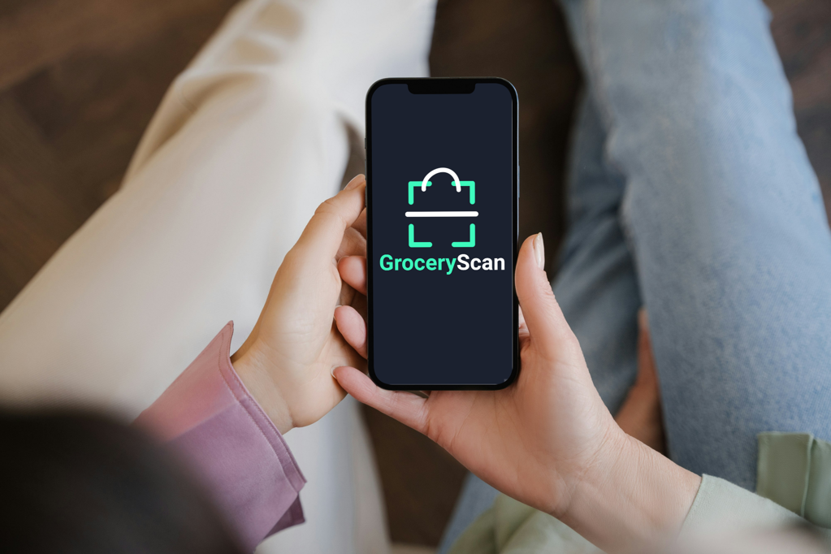
K. Sólyomvári, B. Beregi, Á. Dienes
BDL – Teamwork presentation

Slide 2




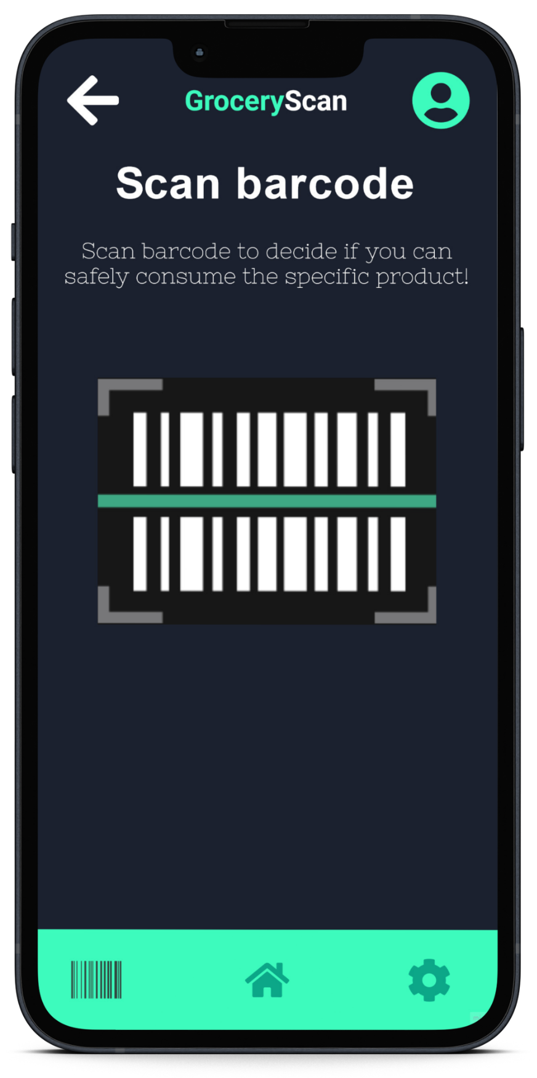
The solution
Barcode scanning in stores
Provide valid answer based on the ingredients
Instant alternatives
Make life with allergies easier

Slide 3
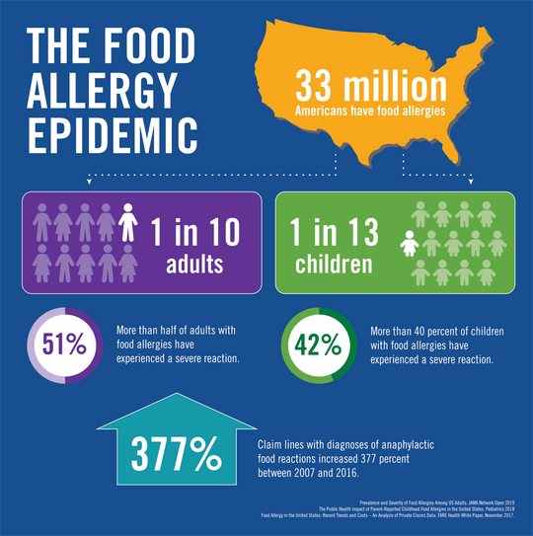
Market analysis
Age range: 18-32
Initial market: United States
Target amount: 20 million
With CR 0.5% = 100 000 ppl
Pilot city: Los Angeles
Potential users: 15 000 ppl
Closed beta users: 700 ppl

Slide 4

Financial metrics Revenue run rate
€10 monthly with 700 users = €7,000/month
Projected run rate in 12 months = €84,000/year

Slide 5
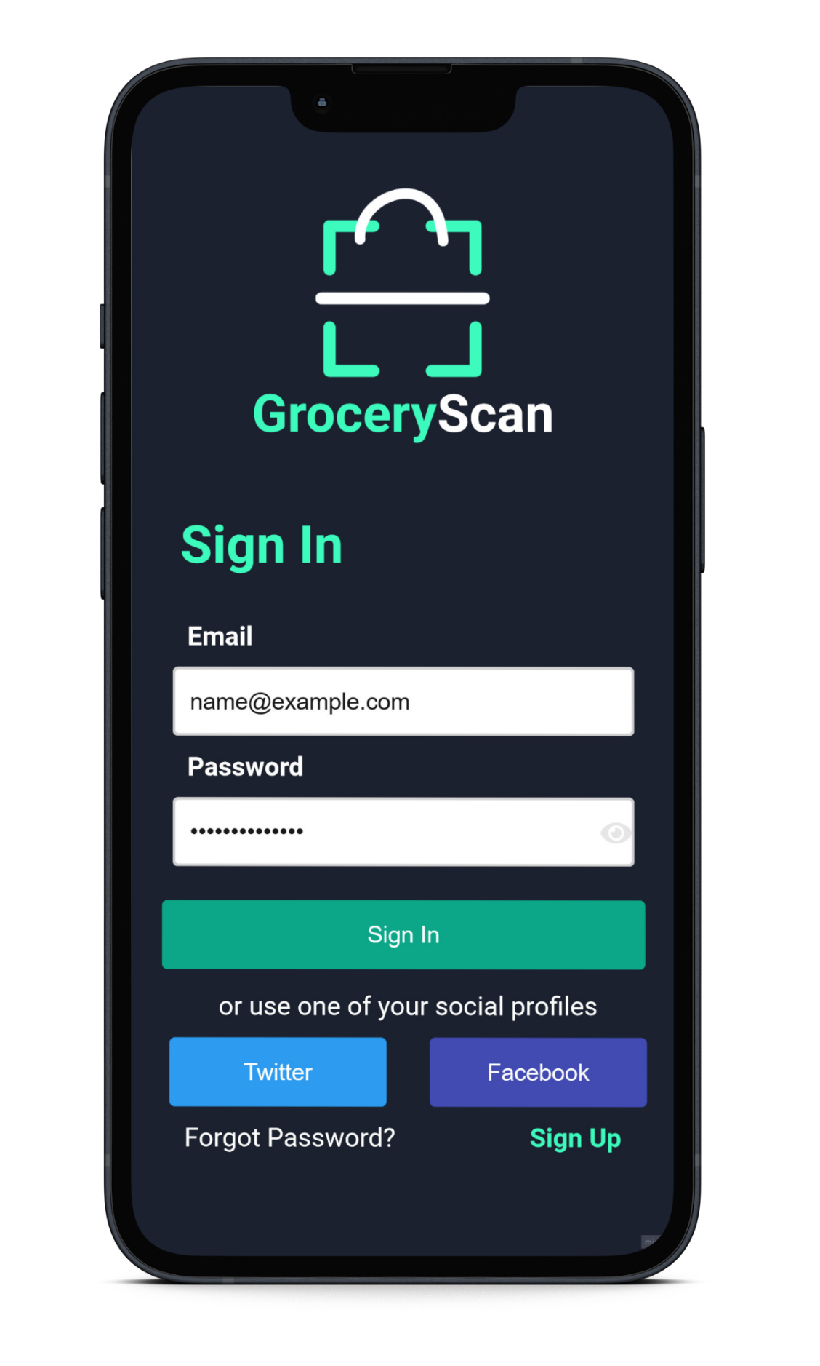
Financial metrics Burn rate and runway
Development | €200,000
Marketing | €100,000
Office and servers | €50,000
Burn rate = (€300,000 + €100,000 + €50,000) / 12 = €37,500 / month
Runway = €1,000,000 / 37,500€ = 26 months* *Due to the initial angels investor and incubator programmes

Slide 6
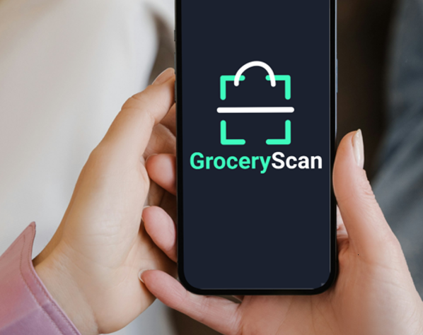
User metrics
K-value
Viral for ~0.5 years \ k=1.3
Paid \ k=1.1
Try to maintain forever
Be happy!

Slide 7

Predicted growth value
K-value decreased Virality is over

Slide 8
User metrics Churn rate (monthly)
Viral 10
Paid 1.3

Slide 9
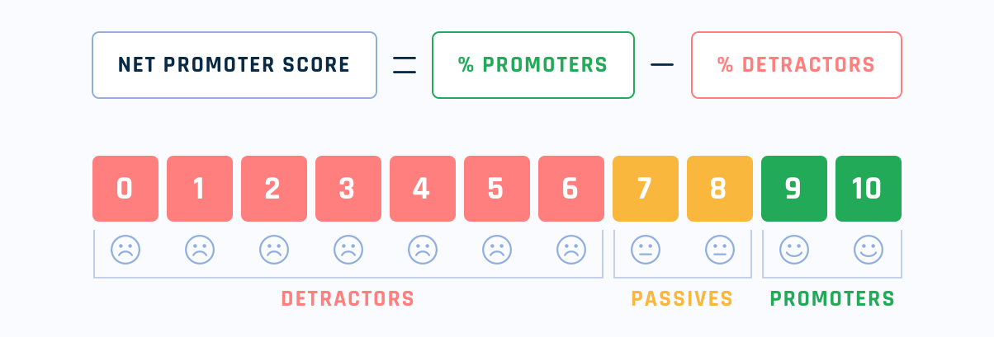
UA metrics Net Promoter Score
65% promoters – 10% detractors = NPS 55

Slide 10
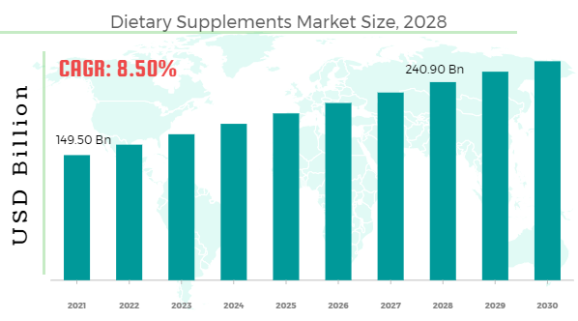
Market metrics Total addressable market
“According to Facts and Factors, the Global Dietary Supplements Market Size was worth USD 149 billion in 2021 and will grow 8.50% to USD 240 billion by 2028.” (according to source)

Slide 11

Sales metrics Magic number
|(Q2 – Q1)| * 4 / expenses = 6,300 * 4 / (3 * 37,500) =0.224

Slide 12

Thank you for your attention!
Are there any questions?

